Slide 1
Reinforcement Learning for Energy-Aware Lunar Rover Navigation Using Chandrayaan-3 NavCam Imagery
Project Proposal Presentation
by
A ANTO KELVIN PRABHU(2448501)
Project Guide
Dr. Vaidhehi
Department of Computer Science
CHRIST(Deemed to be University), Bengaluru-29

Slide 2
1. Introduction
A research proposal focused on advancing lunar terrain analysis through machine learning.
Research Domain: Astrophysics & Lunar Topology.
Project Overview: Reinforcement Learning for Energy-Aware Lunar Rover Navigation Using Chandrayaan-3 NavCam Imagery.
Objective: Develop a reinforcement learning (RL)-based system using Chandrayaan-3 NavCam images to improve lunar rover path planning while considering energy efficiency and terrain challenges.

Slide 3
2. Chandrayaan-3 Mission & NavCam
Chandrayaan-3 successfully landed on the Moon Surface.
Rover Pragyan was equipped with Navigation Cameras (NavCam) for obstacle detection and path planning.
NavCam provides high-resolution images that allow for terrain analysis and path optimization.

Slide 4
3. Existing Research
Rule-based Path Planning: Fixed waypoint navigation with minimal adaptability.
Digital Elevation Models (DEMs): Used for terrain modeling but lacks real-time adaptability.
Photogrammetry & Structure from Motion (SfM): Convert 2D images into elevation models.
Machine Learning Approaches: Mostly simulation-based with limited real data integration.

Slide 5
4. Research Gap
.
Static path planning may not adapt to new obstacles.
Energy inefficiency due to unnecessary deviations. Lack of real-world reinforcement learning integration in lunar terrain. No direct utilization of Chandrayaan-3 NavCam data for RL-based navigation.

Slide 6
5. Research Problem Statement & Objectives
Research Problem
Need for AI/ML-based automation to extract meaningful insights from NavCam imagery.
Efficient path planning on lunar terrain requires optimization considering energy consumption and navigation constraints.

Slide 7
6. Research Objectives Primary Goal: Develop a Reinforcement Learning (RL)-based navigation system that optimizes rover path planning using Chandrayaan-3 NavCam data. Specific Objectives:Integrate real lunar imagery into reinforcement learning models. Create a cost-based terrain model for safe and energy-efficient movement. Train an RL agent (Q-learning or Deep Q-Network) to learn optimal paths. Compare RL-based navigation with traditional rule-based methods. Validate energy consumption and path efficiency improvements.
.

Slide 8
7. Methodology & Approach
.
1.Data Acquisition & Preprocessing
Utilize Chandrayaan-3 NavCam images as the primary dataset.
Apply image preprocessing techniques such as noise reduction, grayscale conversion, and contrast enhancement.

Slide 9
2. Grid-Based Surface Analysis
Divide the terrain into structured grids (e.g., 4×4 or 8×8 cells).
Extract local features such as elevation, slope, roughness, and surface composition.
Assign energy cost and reward values based on terrain difficulty and traversal efficiency.

Slide 10
3. Reinforcement Learning-Based Navigation
Define the state-space, action-space, and reward function based on:
Energy consumption factors.
Surface complexity and obstacles.
Optimal path planning for safe traversal.
Train an RL agent (e.g., Deep Q-Networks, PPO, or A3C) to navigate from an initial position to a target location while optimizing energy usage and avoiding hazardous regions.
Simulate various lunar terrain scenarios to evaluate the model's performance.

Slide 11
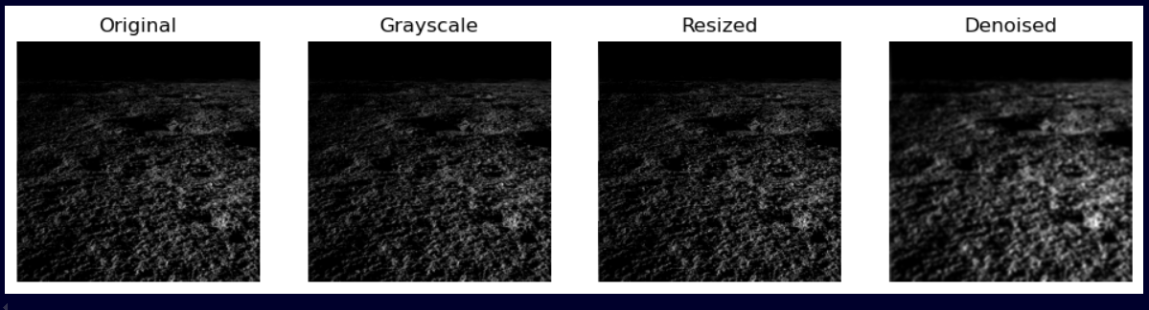
Image Preprocessing

Slide 12
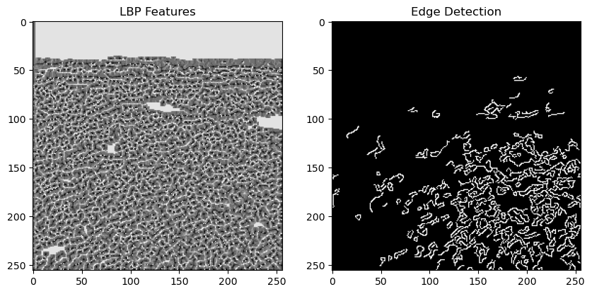
Surface Terrain Rough detection

Slide 13
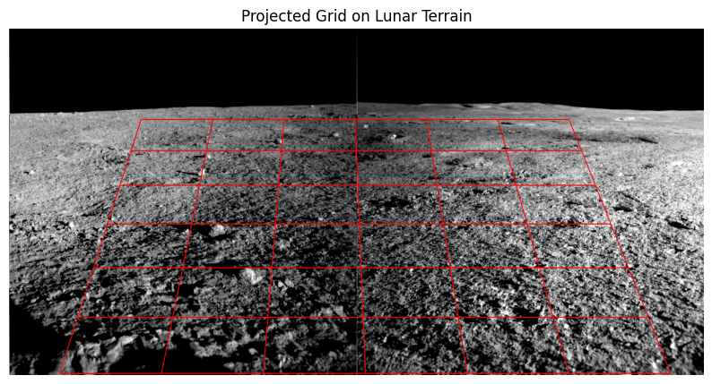
Grid Projection

Slide 14
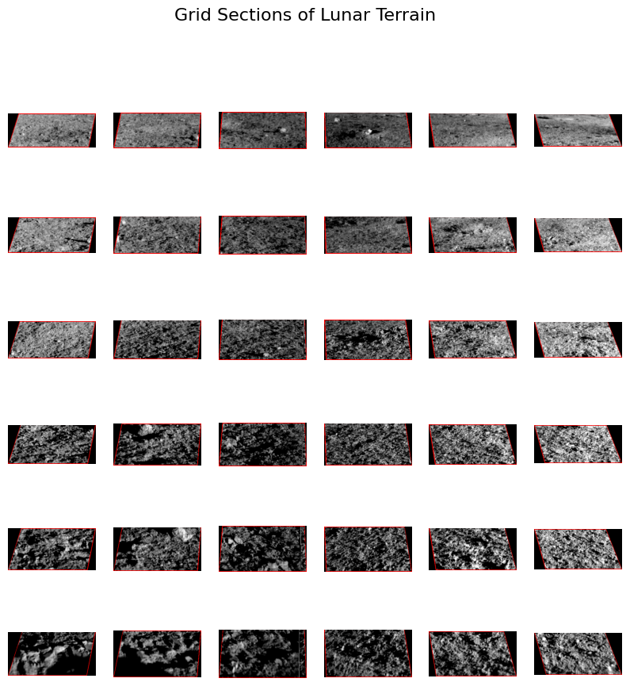
Grid Sections

Slide 15
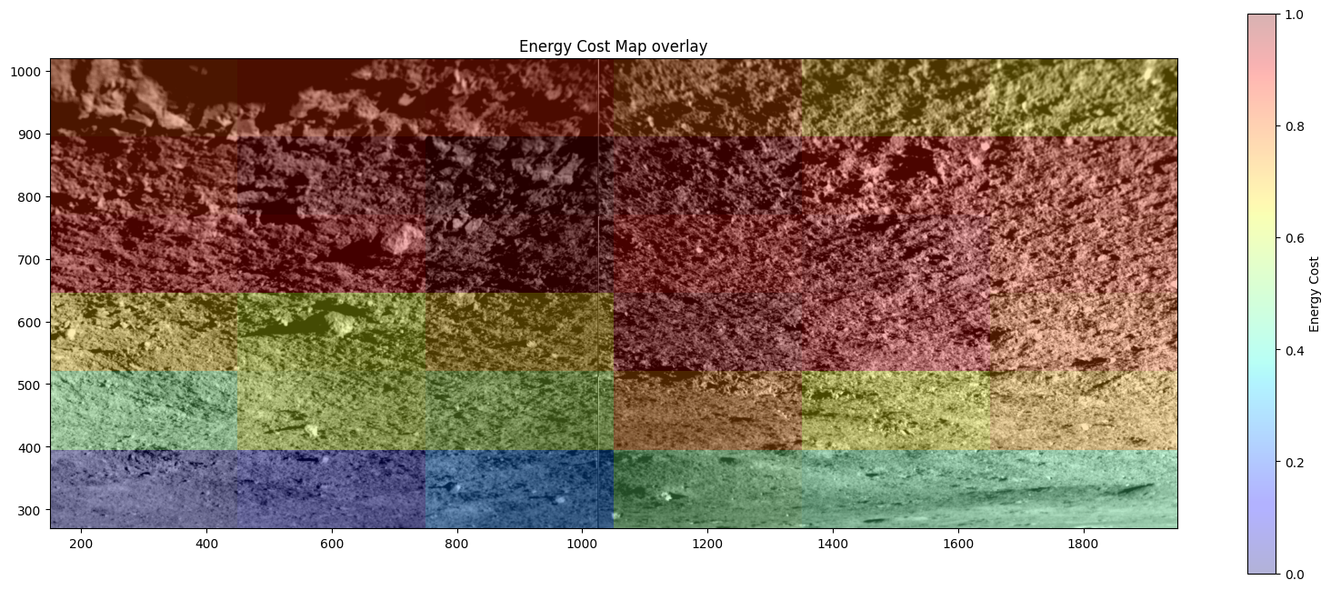
Energy Cost Map

Slide 16
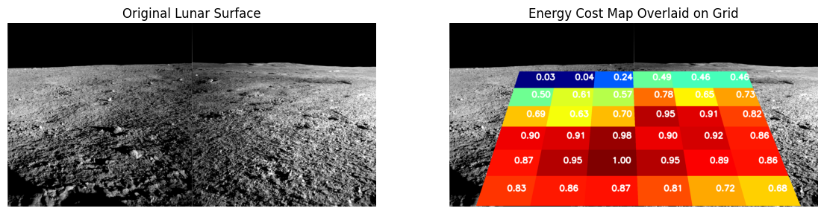
Energy Cost Map overlaid

Slide 17
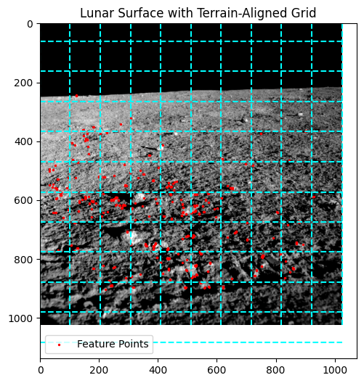
Uneven point detection on projected points

Slide 18
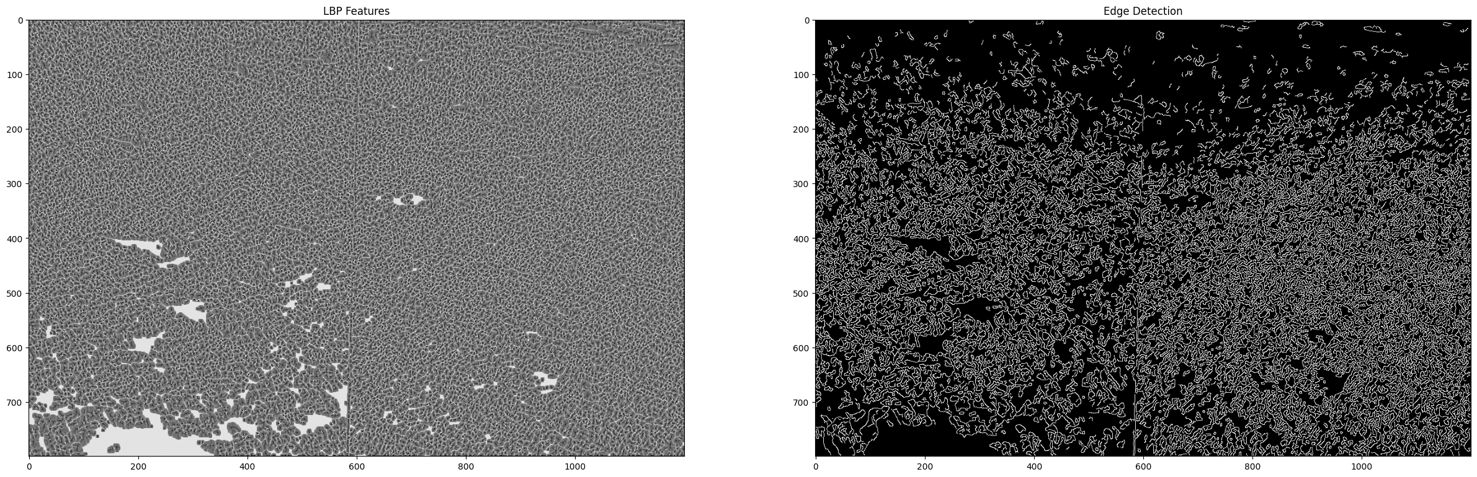
LBP features detection and edges on projected

Slide 19
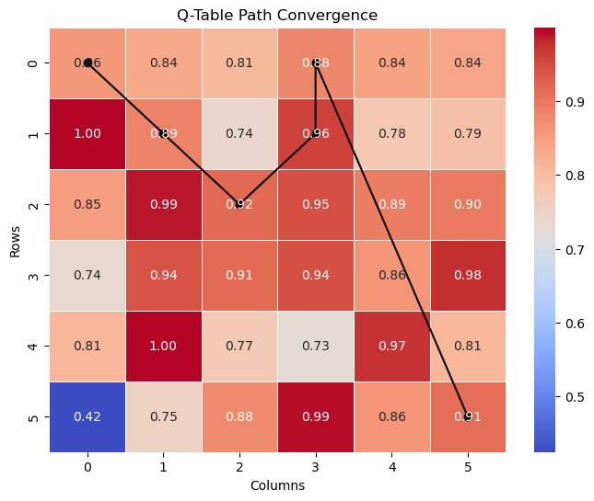
Reward Matrix

Slide 20
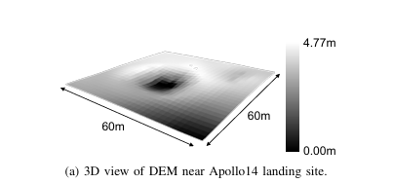
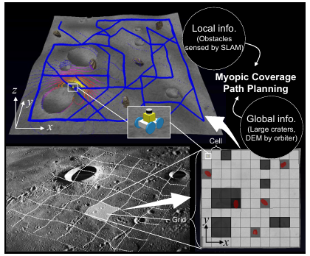
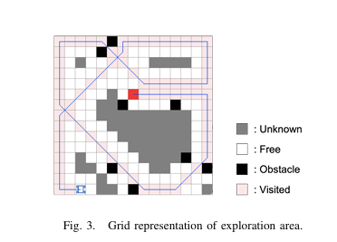
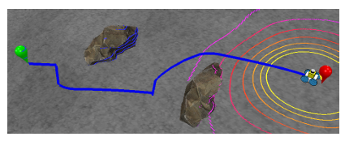
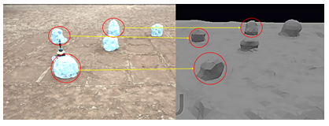
Research Reference and inspiration

Slide 21
8. Dataset Description
Source: Chandrayaan-3 NavCam (Navigation Camera) images captured by Pragyan Rover.
Data Type: High-resolution colored images of the lunar terrain.
Processing Methods:
Key Features Extracted:
Obstacles: Rocks, craters, uneven surfaces.
Slope Analysis: Steep vs. flat areas for safe navigation.
Energy Cost Estimation: Terrain difficulty impacting rover power consumption.

Slide 22
8. SDG goals
SDG 9 – Industry, Innovation, and Infrastructure
Advances in autonomous lunar exploration contribute to technological innovation and infrastructure development for future space missions.
SDG 13 – Climate Action
Enhancing robotic navigation efficiency on the Moon can support future sustainable space exploration, reducing the need for excessive resources and optimizing energy consumption.
SDG 17 – Partnerships for the Goals
Collaboration between academic institutions, space agencies, and AI researchers fosters global partnerships in space research and exploration.

Slide 23
8. References
Key References:Gagnon, J. E., Fryer, B. J., & Weis, D. (2006). Lunar Surface Composition Analysis Using LIBS Data.
Zhao, Y., & Johnson, S. (2018). Thermal Mapping Techniques in Astrophysics.
Kumar, R., & Gupta, P. (2022). Machine Learning Approaches for Lunar Geology.
ISRO Documentation on Chandrayaan-3.

